Slide 1


Micro Credit Defaulter Analysis
Nimit Shah

Slide 2
Table of Contents
Introduction
Analytical Problem Framing
Data Analysis
Assumptions
Machine Learning Models
Results and Conclusion
Limitations and Scope for Future Work

Slide 3
Introduction
A Microfinance Institution (MFI) is an organization that offers financial services to low income populations. MFS becomes very useful when targeting especially the unbanked poor families living in remote areas with not much sources of income. The Microfinance services (MFS) provided by MFI are Group Loans, Agricultural Loans, Individual Business Loans and so on.
They are collaborating with an MFI to provide micro-credit on mobile balances to be paid back in 5 days. The Consumer is believed to be defaulter if he deviates from the path of paying back the loaned amount within the time duration of 5 days. For the loan amount of 5 (in Indonesian Rupiah), payback amount should be 6 (in Indonesian Rupiah), while, for the loan amount of 10 (in Indonesian Rupiah), the payback amount should be 12 (in Indonesian Rupiah).
Using the historical data of the customer on their recharges, we will be predicting the defaulters with the help of Machine Learning models.

Slide 4
Analytical Problem Framing
As explained in the introduction, we will be predicting whether the customer is going to default the loan or not using the given dataset.
There are 209593 rows and 35 columns. Using this dataset we will be training the Machine Learning models on 77% of the data and the models will be tested on 33% data.
There are no null values in the dataset, however it can present us with some un-realistic data that we have to treat before building a machine learning model.
This data was collected for the UPW telecom circle in the year 2016. Below are the definition for each variable available on the dataset

Slide 5
Data Analysis
“Unnamed:0” – This row is a dummy row just like an indexing starting from 1
“msisdn” – The data definition column above clearly states that this is a subscriber mobile number and they are randomly generated and will not have any meaning in the prediction of credit defaulters.
“pcircle” – This feature is same throughout the rows (UPW) and will not have any effect on the target variable
Most of the variables are of numeric data type, except the date column. We have extracted the information of month and day from it and we have deleted the original feature post extraction.

Slide 6
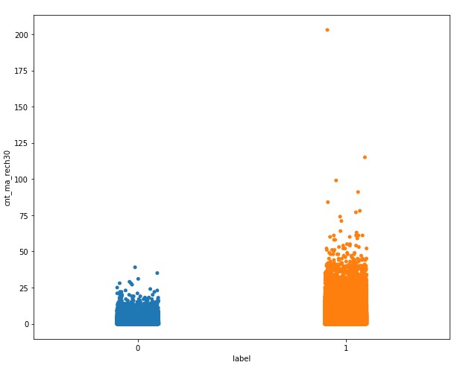
Now, there are no null values in the dataset and all the columns contains numerical data. We can proceed with finding the correlation of the dependent variable with the independent variables.
Let’s look at some of the highly correlated variables
The variable cnt_ma_rech30 (Number of times main account got recharged in last 30 days) has a correlation coefficient of 0.24

Slide 7
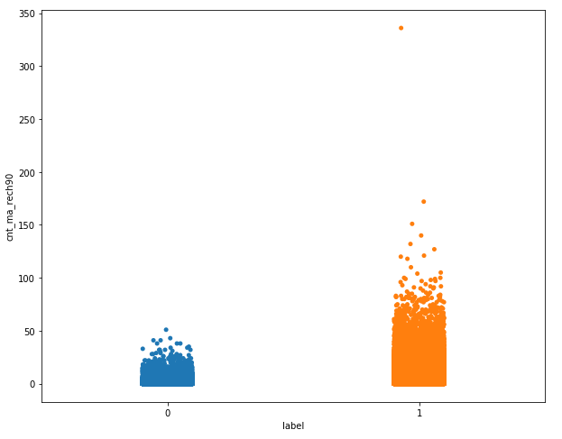
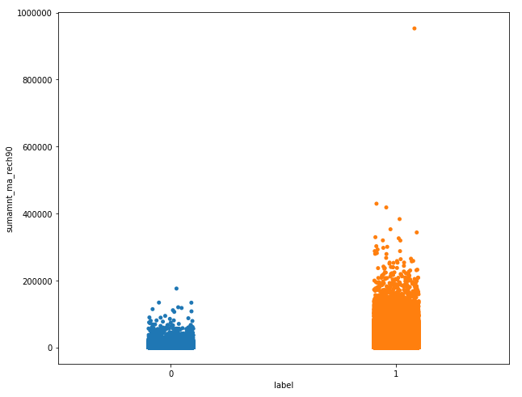
The variable cnt_ma_rech90 (Number of times main account got recharged in last 90 days) has a correlation coefficient of 0.24 and the variable sumamnt_ma_rech90 (Total amount of recharge in main account over last 90 days ) has a correlation coefficient of 0.206 with the target variable

Slide 8
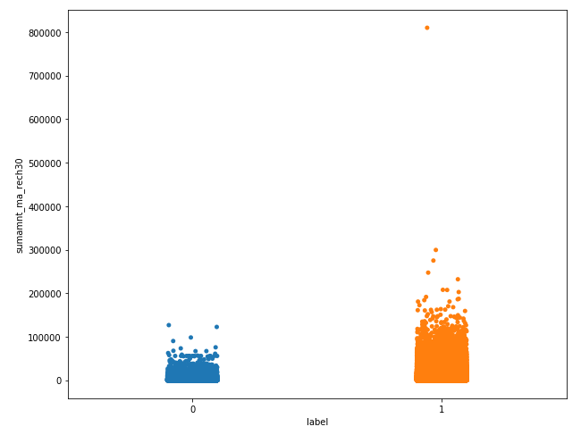
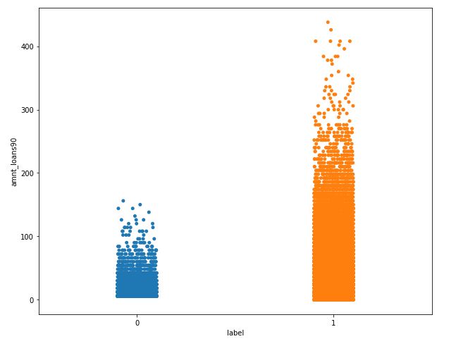
The variable sumamnt_ma_rech30 (Total amount of recharge in main account over last 30 days) has a correlation coefficient of 0.20 and the variable amnt_loans90 (Total amount of loans taken by user in last 90 days) has a correlation coefficient of 0.20 with the Target variable

Slide 9
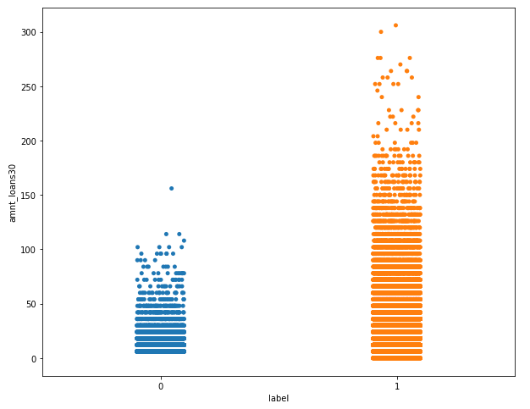
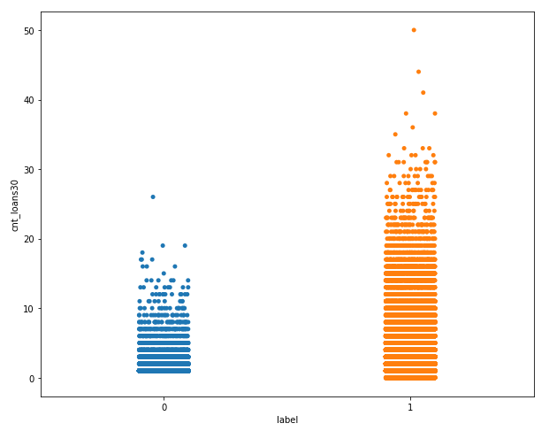
The variable amnt_loans30 (Total amount of loans taken by user in last 30 days) has a correlation coefficient of 0.20 and the variable cnt_loans30 (Number of loans taken by user in last 30 days) has a correlation coefficient of 0.20 with the Target variable

Slide 10
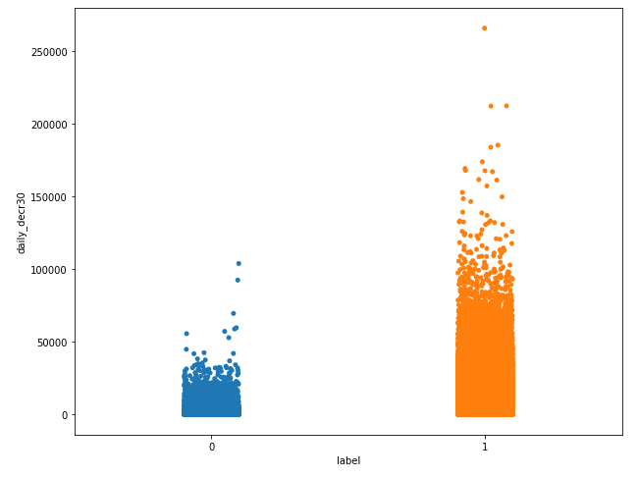
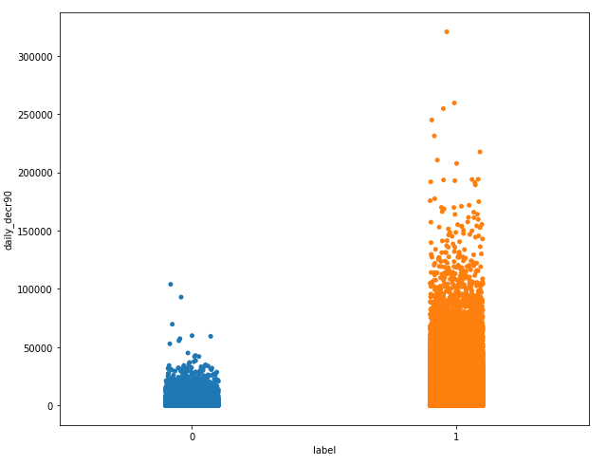
The variable daily_decr30 (Daily amount spent from main account, averaged over last 30 days (in Indonesian Rupiah)) has a correlation coefficient of 0.17 and the variable daily_decr90 (Daily amount spent from main account, averaged over last 90 days (in Indonesian Rupiah)) has a correlation coefficient of 0.17 with the Target variable

Slide 11
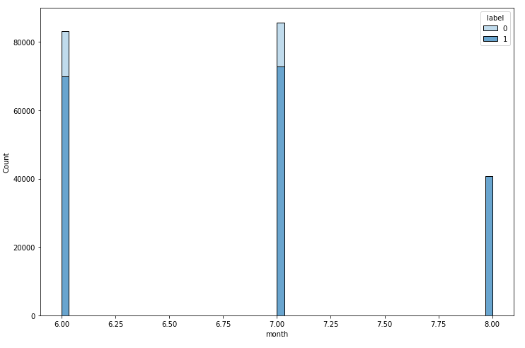
The customers who took the loan in the month of August didn’t default the loan when compared to other months

Slide 12
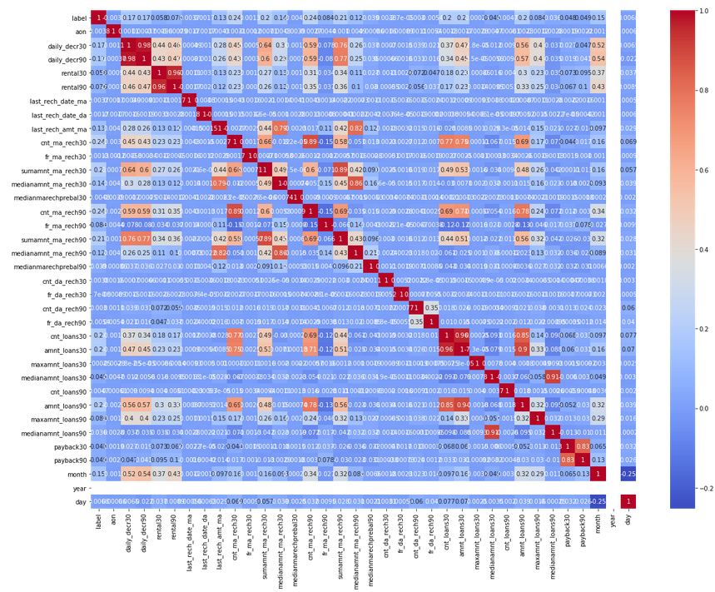
Now that we have analyzed the correlation between the dependent and independent variables, we can move forward in analyzing the multi-collinearity.
From the heat-map I can see that there are lot of independent variables are correlated and I can see multi-collinearity in the dataset.

Slide 13
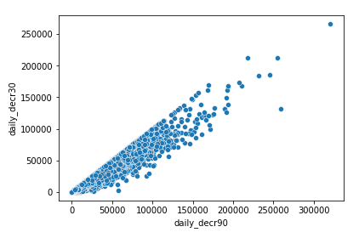
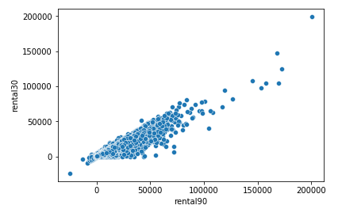
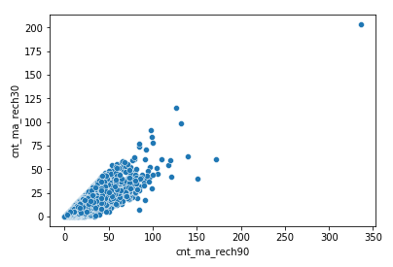
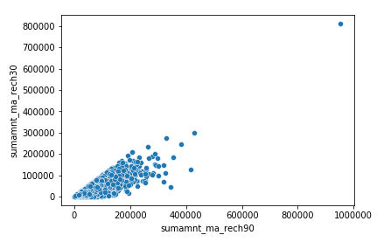
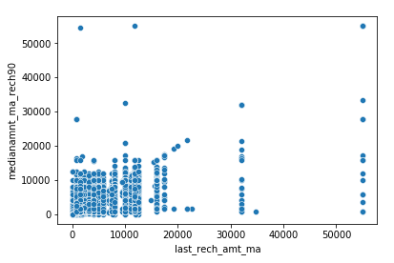
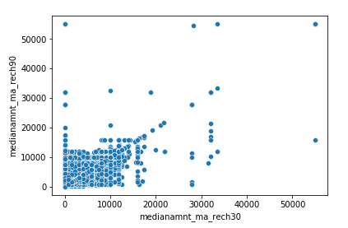
Visualizing the correlated independent variable with greater than 0.8 correlation coefficient

Slide 14
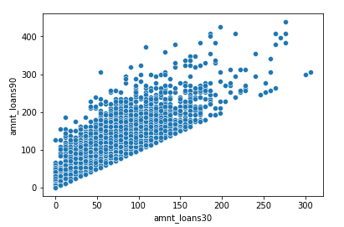
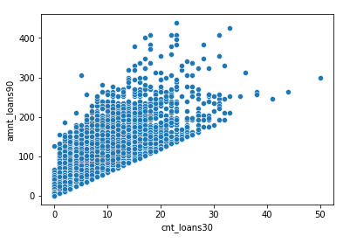
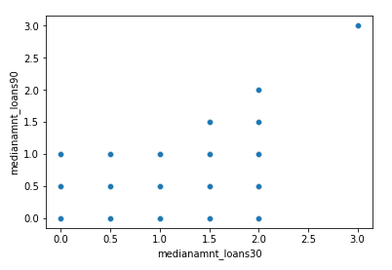
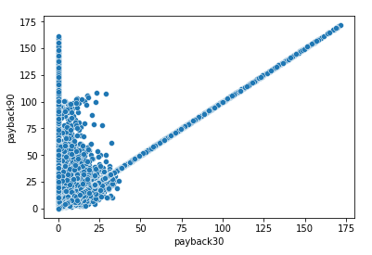
Continued…

Slide 15
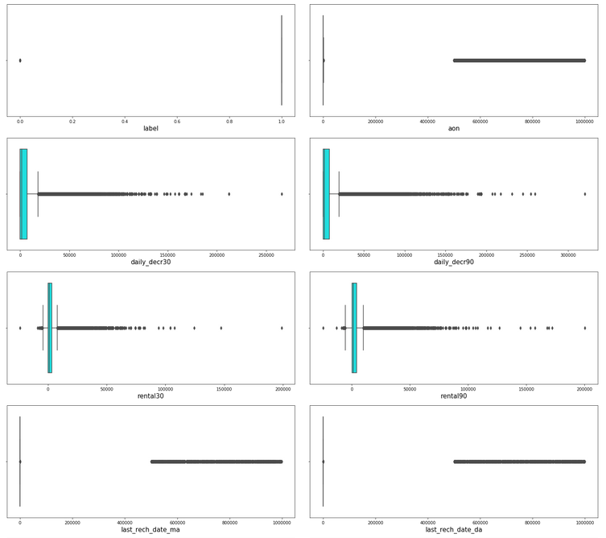
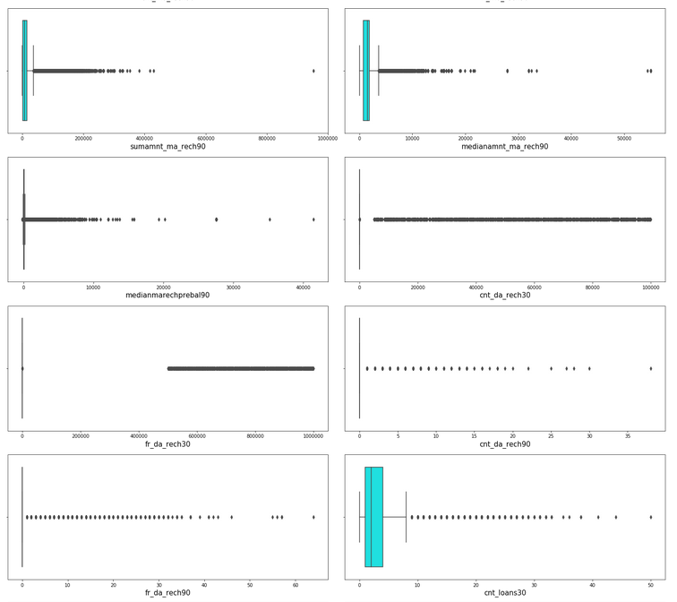
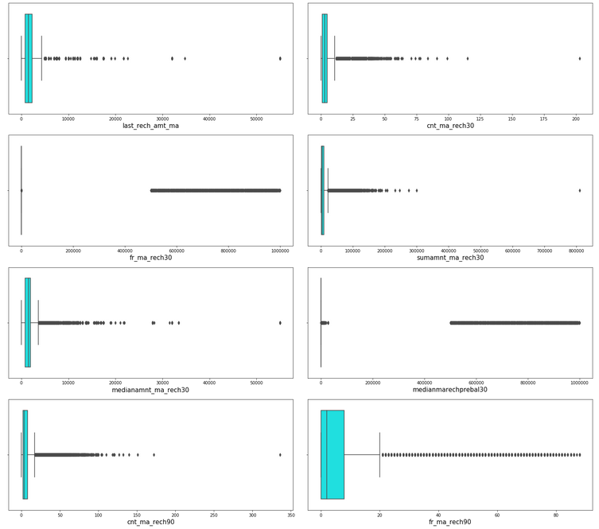
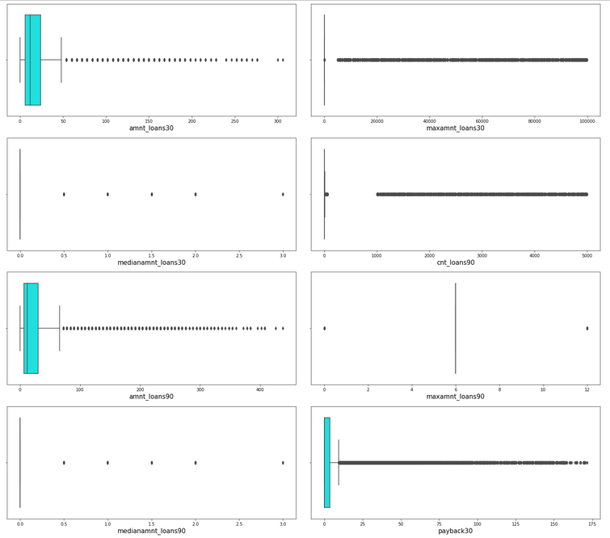
Checking for outliers using boxplot from the seaborn documentation

Slide 16
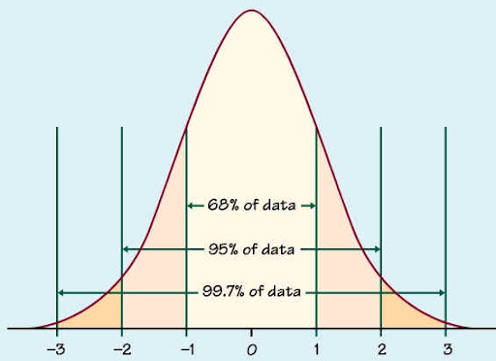
The previous slide clearly implies that lot of variables has outliers in the data and we can remove them using the statistics.
First we find the p-value of each and every data point and we take only data with less than 2.8 p-value.
It is assumed that close to 99.7% data lies between -3 to +3 standard deviation. We can consider the remaining data (0.03) to be outlier.
Therefore using the z-score method, I’m taking the data within the range of -2.8 to +2.8 standard deviation to control the outlier.

Slide 17
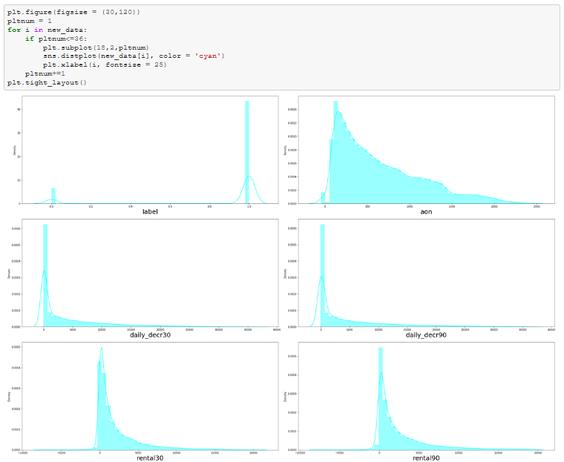
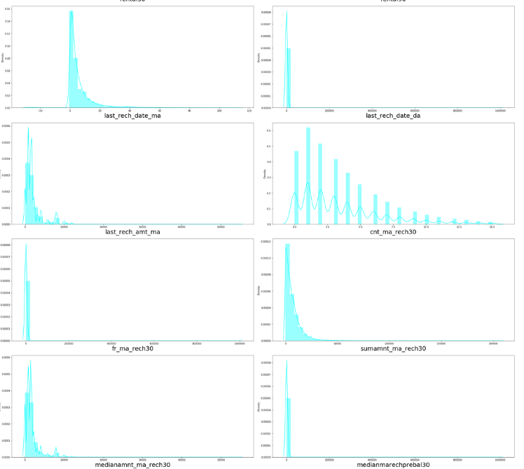
Checking for skewness in the dataset using the distribution plot from a seaborn library

Slide 18
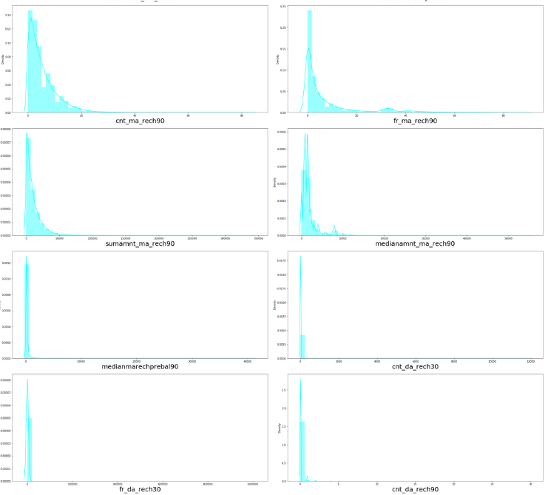
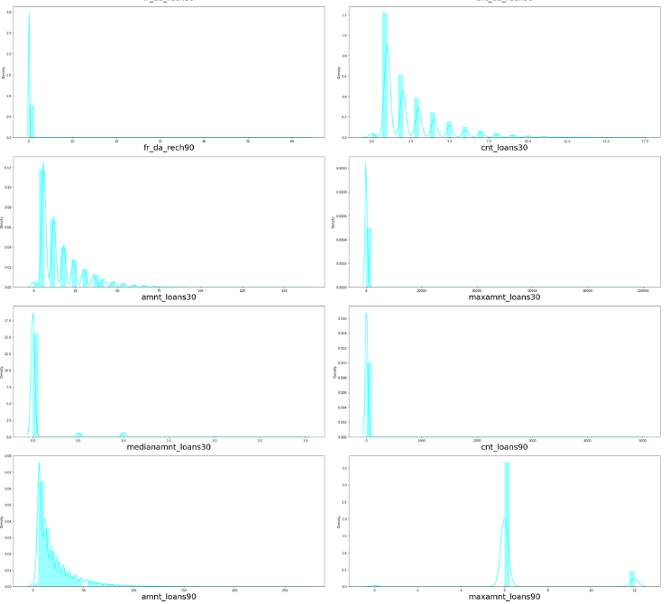
Continued…

Slide 19
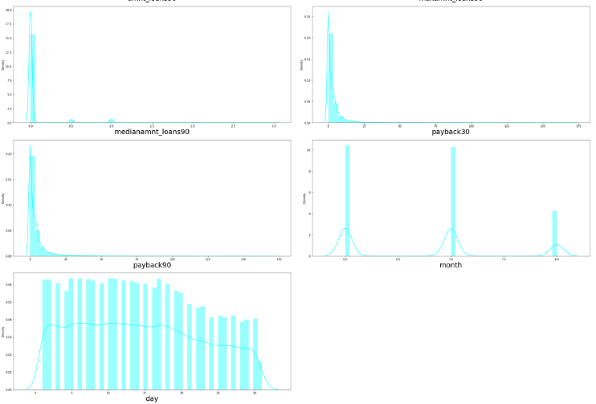
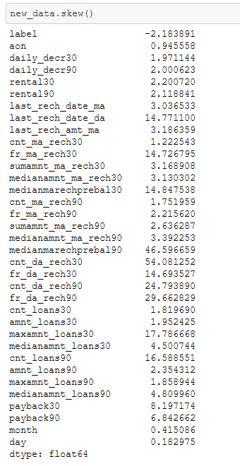
Continued…

Slide 20
From the previous slides, we can clearly see that there are few ordinal variables, few discrete variables and most part with continuous variable.
In order to be a good dataset, we assume that all the continuous variables follow normal distribution. However I can see that the continuous columns are skewed and we will have to control skewness to make data follow normal distribution.
It is considered that the skewness co-efficient within the range of -0.5 to +0.5 is acceptable. Proceeding with the same assumption to get the skewness under control.
In order to perform the same we are using power transformation using ‘yeo-johnson’ method and cube-root transformation on the entire dataset excluding the target variable.

Slide 21
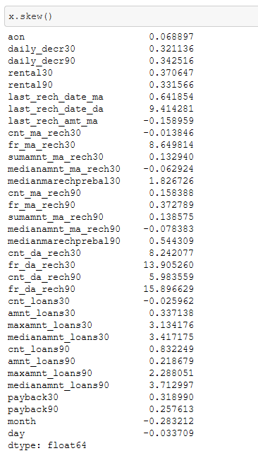
Most of the skewness are under control except few and we are proceeding with the model building assuming that outliers is not the cause of the skewness in the dataset

Slide 22
Assumptions
Although there is skewness present in some of the variables post transformation, we assume that this is not because of the presence of outliers, however it is the shape of the data itself
We assume that all the variables follow normal distribution
The multi-collinearity in the dataset will not affect the prediction.
Scaling the data in order to keep all the variables with in the desired numerical range.

Slide 23
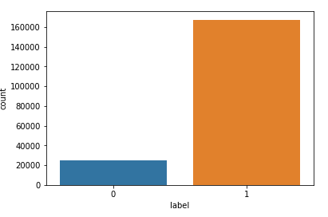
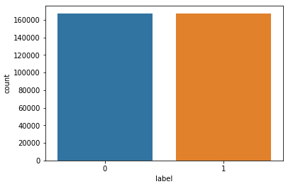
We identified that there was class imbalance in the dataset, before proceeding with the model building, I’m balancing the class using SMOTE over-sampling technique.
This is necessary because, if the balancing is not done the model tends to predict the majority class better and the minority class will not be accurately predicted.
Below plots compare the class count before and after performing SMOTE

Slide 24
Machine Learning Models
Below are the details of the machine learning model used
ML Model | Accuracy Score | Precision | Recall | F1 Score | AUC Score | Accuracy (CV)
Logistic Regression | 0.77 | 0.77 | 0.77 | 0.77 | 0.77 | 0.771
Random Forest Classifier | 0.95 | 0.95 | 0.95 | 0.95 | 0.95 | 0.946
Extra Trees Classifier | 0.96 | 0.96 | 0.96 | 0.96 | 0.96 | 0.962
XG Boost Classifier | 0.95 | 0.95 | 0.95 | 0.95 | 0.95 | 0.932
K - Neighbors Classifier | 0.87 | 0.87 | 0.87 | 0.87 | 0.87 | 0.867

Slide 25
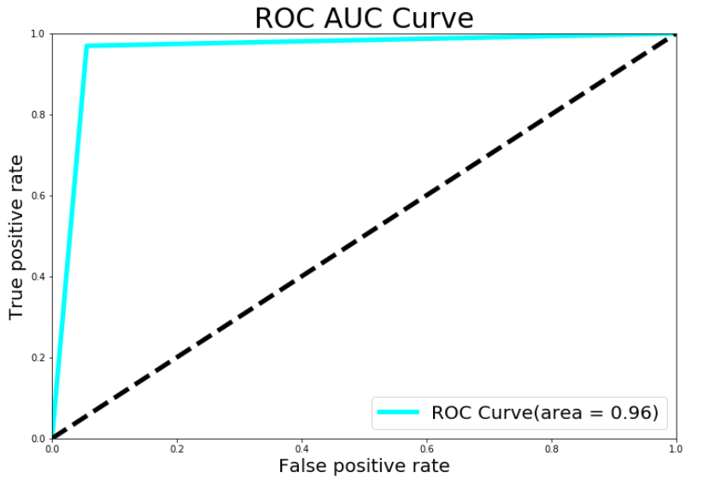
As per the previous slide the chosen best model for the dataset is Extra Trees Classifier
Below is the ROC AUC Curve

Slide 26
Results and Conclusion
We have successfully built a model using multiple models and found that the Extra
Trees Classifier model.
Below are the details of the model’s metrics predicting the dataset
1. Average precision of 0.96
2. Average recall of 0.96
3. F1 Score is 0.96
4. The ability of a classifier to distinguish between classes (AUC) is also 0.96.

Slide 27
Below are the major contributing variables for the prediction:
cnt_ma_rech30 - 0.237331
cnt_ma_rech90 - 0.236392
sumamnt_ma_rech90 - 0.205793
sumamnt_ma_rech30 - 0.202828
amnt_loans90 - 0.199788
amnt_loans30 - 0.197272
cnt_loans30 - 0.196283
daily_decr30 - 0.168298
daily_decr90 - 0.166150
month - 0.154949
medianamnt_ma_rech30 - 0.141490
last_rech_amt_ma - 0.131804
medianamnt_ma_rech90 - 0.120855

Slide 28
Limitations and Scope for Future Work
Due to the presence of lot of outlier, we are unsure whether the model is going to perform well to a completely new dataset.
Due to a class imbalance, we had to rebalance the class 0. This might also have some effect while trying to predict the outcome with completely new data
During data-collection, we could place limits on few continuous variables, where the customer could enter data within a limit because the variables like age on the network cannot be more than certain months

Slide 29


